Slide 1
Azure Key Vault
Azure User Group - Denmark
17. Nov 2015

Slide 2
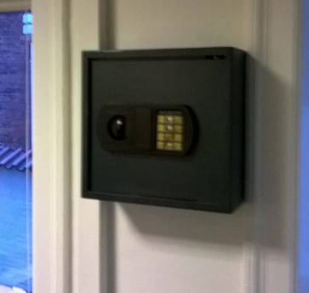
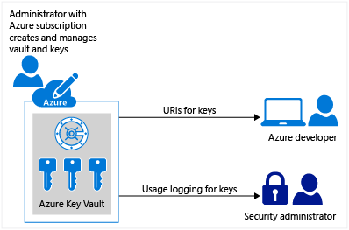
Analog Key Vault
Jeg henter nøglen i skabet / afleverer den tilbage når jeg går igen.
Koden til skabet er oprettet og oplyst af min kunde.

Slide 3
Getting started
New-AzureResourceGroup –Name 'ContosoResourceGroup' –Location 'East Asia'
New-AzureKeyVault -VaultName 'ContosoKeyVault' -ResourceGroupName 'ContosoResourceGroup' -Location 'East Asia'
$key = Add-AzureKeyVaultKey -VaultName 'ContosoKeyVault' -Name 'ContosoFirstKey' -Destination 'Software'
(eller)
$key = Add-AzureKeyVaultKey -VaultName 'ContosoKeyVault' -Name 'ContosoFirstKey' -KeyFilePath 'c:\softkey.pfx' -KeyFilePassword $securepfxpwd
$secretvalue = ConvertTo-SecureString 'Pa$$w0rd' -AsPlainText -Force
$secret = Set-AzureKeyVaultSecret -VaultName 'ContosoKeyVault' -Name 'SQLPassword' -SecretValue $secretvalue
$secret.Id -> https://ContosoVault.vault.azure.net/secrets/SQLPassword
Specifik version
https://ContosoVault.vault.azure.net/secrets/SQLPassword/90018dbb96a84117a0d2847ef8e7189d

Slide 4
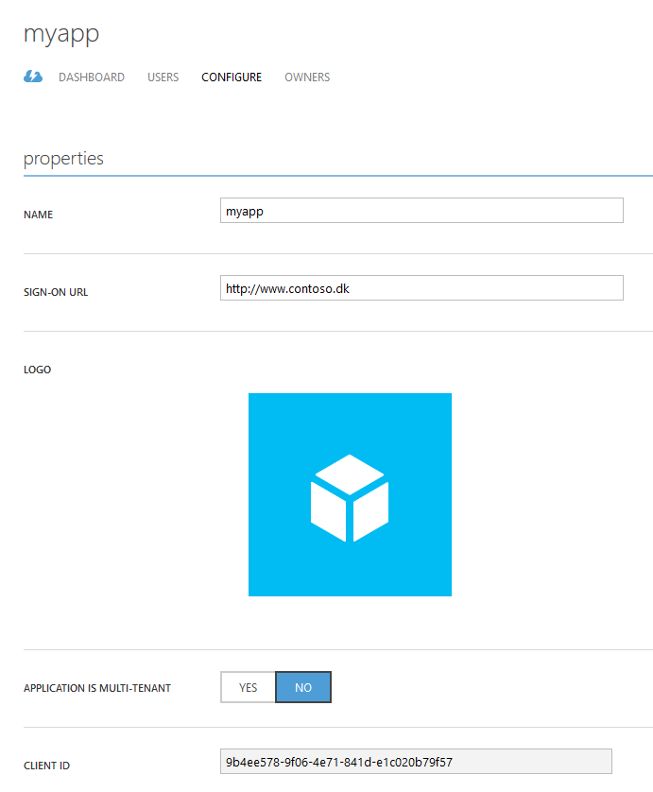
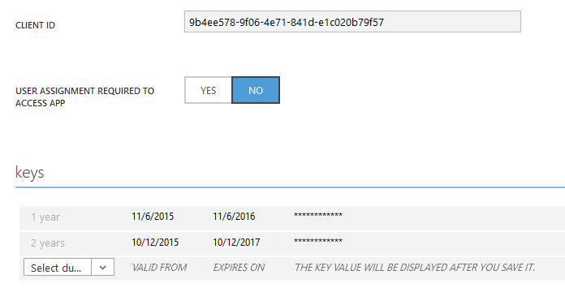
Register application
Gemmes
Gemmes

Slide 5
SQL – Always Encrypted
Kan jeg beskytte mine data (on-the-fly-encryption)
Kan jeg stjæle ”rå-database”
Kan jeg stjæle en backup
Demo
Vi har tidligere kunne anvende symmetriske og a symmetriske nøgler
hvad nu?

Slide 6
Her troede jeg at jeg var klar med min præsentation...
http://blogs.technet.com/b/dataplatforminsider/archive/2015/10/26/azure-key-vault-integration-for-sql-server-in-azure-vms.aspx
$vmName = “yourvmname”
$serviceName = “yourservicename”
$secureakv = $spSecret | ConvertTo-SecureString -AsPlainText -Force
$akvs = New-AzureVMSqlServerKeyVaultCredentialConfig –Enable –CredentialName $credname –AzureKeyVaultUrl $akvURL –ServicePrincipalName $spName –ServicePrincipalSecret $secureakv
Get-AzureVM –ServiceName $serviceName –Name $vmName | Set-AzureVMSqlServerExtension –KeyVaultCredentialSettings $akvs | Update-AzureVM

Slide 7
Key Vault - Logging
http://blogs.technet.com/b/kv/archive/2015/11/10/keyvault_2d00_logging_2d00_preview.aspx
Azure PowerShell 1.0.1
https://github.com/Azure/azure-powershell/releases/tag/v1.0.1-November2015

Slide 8
Demo – Poul tryller

Slide 9
Hands-on
https://azure.microsoft.com/en-us/documentation/articles/key-vault-get-started/
https://azure.microsoft.com/en-us/documentation/articles/key-vault-use-from-web-application/

